Slide 1
© FINBOA – Proprietary and Confidential 2022

Slide 2
FINBOA Snapshot
HQ: Houston, TX
Founded 2016 by Raj Singal
Mission: Freeing people to do meaningful work
Apply digitization and intelligent automation to improve compliance, efficiency and customer experience across the banking enterprise
150+ banks and credit unions trust FINBOA
Strong growth through partnerships
Houston Fast 100 award for business growth
© FINBOA – Proprietary and Confidential 2022

Slide 3
FINBOA Makes It Easy
1
2
3
4
Assess your current operational challenges, demonstrate solutions and share the benefits you can expect
Engage with your leadership, IT, risk, ops and support your due diligence
Review what to expect during the implementation and what we need from you
Configure the solution, activate the service, assess next areas for improvement
© FINBOA – Proprietary and Confidential 2022

Slide 4
Digital Operation Imperative
“Banks need to act now to develop an aggressive tactical roadmap that outlines the plan for digitization and automation. Banks that lack a clear long-term automation plan—one that will result in a fully digital operation a decade from now—will struggle to meet customer expectations.”
McKinsey & Company
Notes:
Questions to ask bankers:
How many branches and employees per branch? (100 branches with 3 people = 300 employees that have to be trained on Regs, consistently handling customer disputes)
How many cardholders? (What’s the % of disputes per cardholder in today’s environment?)
Ever have to chase a customer in the parking lot or call customers to get complete information that was missing on the form?
Do you have customers calling and coming to the branch to find out when they’ll get their money?
Have you experienced audit exceptions that your team had to remediate? Do you think that will cause increased scrutiny of your processes the next time?
Payment dispute volumes are increasing in institutions because of dramatic growth in electronic payment usage – embedded eCommerce payments, P2P, Zelle, mobile wallets, ACH, wire, cards…
Spreadsheets and post-it notes not effective for handling volume increases
Errors from re-keying are problematic, customer accounts not credited properly, transpositions
Write-off limits get raised and losses result
Audits require too many people, failing audits or having exceptions involves remediation, more cost and more people
Customers have to drive to branches to sign documents, may not know the status of their dispute and when they get their money back
NONE OF THIS SCALES TO TAKE ADVANTAGE OF THE OPPORTUNITY TO CAPTURE MORE FEE INCOME FROM THIS INCREASE IN PAYMENT VOLUME

Slide 5
FINBOA Digital Operations SaaS Solutions
Digitization
Analytics
Payment Dispute Compliance
Exception Management
Treasury Onboarding and Annual Review
Wires
Loan Onboarding and Risk Analysis
Payment Dispute Compliance
Exception Management
Wires
Loan Onboarding and Risk Analysis
Automation
Compliance
© FINBOA – Proprietary and Confidential 2022
Notes:
We help banks and credit unions transition to a digital operation
Digitize everything that’s paper, static-pdf, being passed around via email, share drives and tracked in spreadsheets
Provide centralized control

Slide 6
Why It Matters: Industry Point of Inflection
Payment Growth Drivers
Digital Payment Use
Americans Making Online, In-App and P2P payments
82%
eCommerce / BNPL
Mobile Wallets
Embedded Payments
P2P / Zelle / Chuck
Real-time
Fraud is Rising
Organizations Impacted
by Payment Fraud
74%
Preferences are Shifting
Debit Cards Preferred
Among 18-24 Year Olds
51%
© FINBOA – Proprietary and Confidential 2022
‹#›

Slide 7
Manual Processes are Not Sustainable
What are the challenges resolving payment disputes in your organization?
Negative customer and staff experience
Missing deadlines and making mistakes
Continuously training and retraining staff
Increasing write-offs and losses
Fearing and failing compliance audits
Missing growth opportunities
Notes:
Questions to ask bankers:
How many branches and employees per branch? (100 branches with 3 people = 300 employees that have to be trained on Regs, consistently handling customer disputes)
How many cardholders? (What’s the % of disputes per cardholder in today’s environment?)
Ever have to chase a customer in the parking lot or call customers to get complete information that was missing on the form?
Do you have customers calling and coming to the branch to find out when they’ll get their money?
Have you experienced audit exceptions that your team had to remediate? Do you think that will cause increased scrutiny of your processes the next time?
Payment dispute volumes are increasing in institutions because of dramatic growth in electronic payment usage – embedded eCommerce payments, P2P, Zelle, mobile wallets, ACH, wire, cards…
Spreadsheets and post-it notes not effective for handling volume increases
Errors from re-keying are problematic, customer accounts not credited properly, transpositions
Write-off limits get raised and losses result
Audits require too many people, failing audits or having exceptions involves remediation, more cost and more people
Customers have to drive to branches to sign documents, may not know the status of their dispute and when they get their money back
NONE OF THIS SCALES TO TAKE ADVANTAGE OF THE OPPORTUNITY TO CAPTURE MORE FEE INCOME FROM THIS INCREASE IN PAYMENT VOLUME

Slide 8
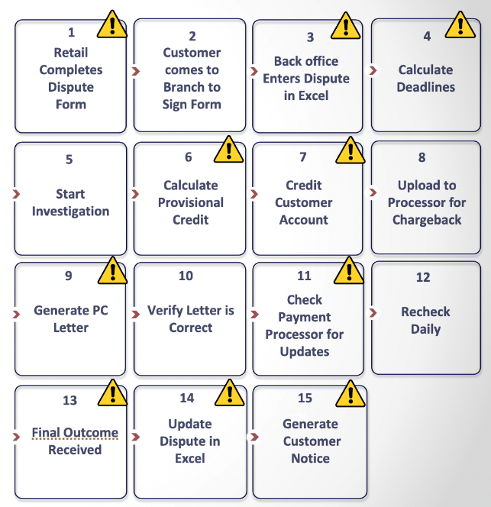
Before FINBOA
Before FINBOA
Downside Risk
Paper forms / static PDF Files
Excel spreadsheet claim tracking
Post-it notes and Outlook reminders
Manual credit calculations
Manual letter creation
Manual daily status updates with
processors and customers
Fines and penalties
Higher write-offs and losses
Human Errors
Negative customer experience
Audit exceptions
CFPB complaints
© FINBOA – Proprietary and Confidential 2022

Slide 9
After FINBOA
With FINBOA Solution
Operational Efficiencies
1
2
No spreadsheets
Automatic reminders and alerts
Automated calculation
Automated letter generation and GL entries
Notification status updates
Trend analysis
Customer/FI Completes Digital Form
FI Runs Provisional Credit Automation
3
4
FI Benefits
Breeze through audits
Turning paper pushers into fraud fighters
Handle growing volumes without additional staff
Reduced fraud
Improved customer experience
FI Completes Investigation
FI Runs Resolution Letter Automation
© FINBOA – Proprietary and Confidential 2022

Slide 10
FINBOA Process Automation
End-To-End Digital
Experience
Bank-Specific Integrations
Pre-Built Compliance Solutions
COMPLIANCE RULES, AUTOMATIONS, DOCUMENT TEMPLATES, WORKFLOWS
Digitize Paper & Static Forms
Electronic Client Signature
Workflow Automation & Decisioning
Core Integration
Document Generation & Management
Dashboard Analytics & Easy Audits
Robotic Integration
PCI DSS
CERTIFIED
CLOUD HOSTED
© FINBOA – Proprietary and Confidential 2022
‹#›

Slide 11
FINBOA Payment Dispute Impacts
90%
25%
3X
Immediate Reduction in Dispute Intake Time
Reduction in Write-offs and Losses
Dispute Volume Increase Supported by Fewer Resources
© FINBOA – Proprietary and Confidential 2022
‹#›

Slide 12
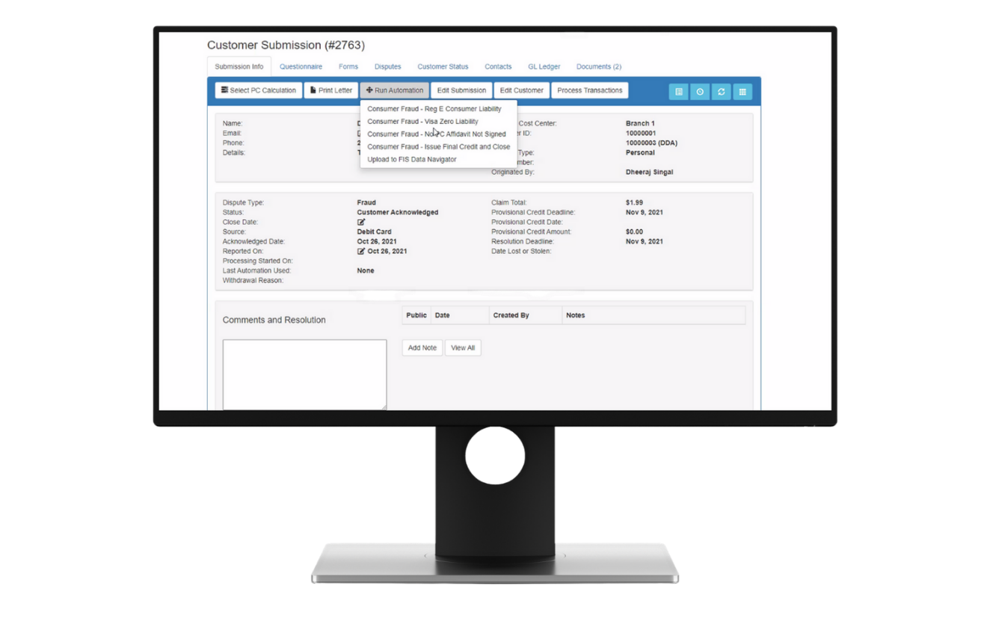
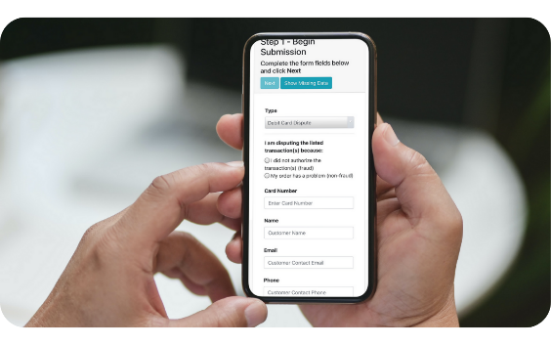
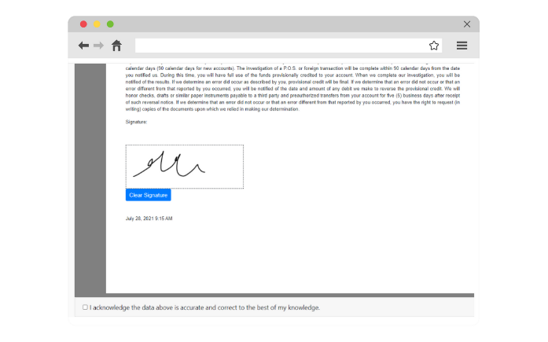
Built-in automation and compliance
Convenient, secure customer experience
Eliminate paper, reduce errors
© FINBOA – Proprietary and Confidential 2022
Notes:
Insert Screenshots to show:
Visibility of activity that needs attention
Data entry on a tablet
Automation example

Slide 13
Integration and Implementation Approach
We work with any core and already support Fiserv, FIS, Jack Henry, Finastra and CSI
We have partnerships in place with CSI and Jack Henry
We integrate to your online and mobile banking and Chargeback systems
File, API and WebBot options
60 to 90 Days to Implement
© FINBOA – Proprietary and Confidential 2022
Notes:
Questions to ask bankers:
How many branches and employees per branch? (100 branches with 3 people = 300 employees that have to be trained on Regs, consistently handling customer disputes)
How many cardholders? (What’s the % of disputes per cardholder in today’s environment?)
Ever have to chase a customer in the parking lot or call customers to get complete information that was missing on the form?
Do you have customers calling and coming to the branch to find out when they’ll get their money?
Have you experienced audit exceptions that your team had to remediate? Do you think that will cause increased scrutiny of your processes the next time?
Payment dispute volumes are increasing in institutions because of dramatic growth in electronic payment usage – embedded eCommerce payments, P2P, Zelle, mobile wallets, ACH, wire, cards…
Spreadsheets and post-it notes not effective for handling volume increases
Errors from re-keying are problematic, customer accounts not credited properly, transpositions
Write-off limits get raised and losses result
Audits require too many people, failing audits or having exceptions involves remediation, more cost and more people
Customers have to drive to branches to sign documents, may not know the status of their dispute and when they get their money back
NONE OF THIS SCALES TO TAKE ADVANTAGE OF THE OPPORTUNITY TO CAPTURE MORE FEE INCOME FROM THIS INCREASE IN PAYMENT VOLUME

Slide 14
FINBOA Customer Feedback
FINBOA delivers digitization and automation SaaS solutions to solve front and back-office onboarding and servicing challenges
“If you can shop online, you can use FINBOA”
Kimberly Mantuano
Centennial Bank
“We supported 3X the volume and redeployed 40% of our team”
Matt Speare
Carter Bank & Trust
“Front-line training went from 3-6 months to proficiency in 2 weeks.”
Mel Channell
Trustmark
© FINBOA – Proprietary and Confidential 2022
‹#›
Notes:
Point of inflection
Perfect storm
Reduced barriers to entry to deliver competing products across loans and deposits
Universal challenges hiring and retaining talent; far fewer people want to be involved in the mundane work of bank operations
Old technology
Manual processes impact customer experience, challenging how banks will compete and win
Economics of customer acquisition, customer service are under pressure

Slide 15
FINBOA SaaS Solutions Software to digitize, automate, analyze and support compliance in bank processes
Payment
Disputes
Exception Management
Treasury
Onboarding
Wires
Loan Onboarding
Pre-Built Workflows
1. Reg E Debit Cards
2. Reg E ACH
3. Reg E ATM
4. Reg E Zelle (using EFT)
5. Reg E Bill Pay (using EFT)
6. Credit Cards
7. Check Fraud
8. Wire Fraud
9. Mobile Deposits
10. Stop Payments
Workflow Enablers
1. New Account
2. New Customer
3. New Loan
Workflow Enablers
1. Digital Onboarding
2. Analytics
3. Risk Assessment
Workflow Enablers
1. Verification
2. Funding Approvals
3. Request Routing
4. Agreement Capture
Workflow Enablers
1. Intake
2. Exceptions
3. Payments
© FINBOA – Proprietary and Confidential 2022
‹#›
Notes:
FINBOA Definition of Workflow = automated sequence of tasks through which data/information passes from process initiation to completion (beginning to end)
Loan Onboarding – Intake, Exceptions, Payments
Exception Management – New Account, New Customer, Loan Review
Treasury Management – digital onboarding, analytics, risk assessment
Payment Disputes – Reg E Reg E Debit Cards, Reg E ACH, Reg E ATM, Reg E Zelle (using EFT), E Bill Pay (using EFT), Reg Z Credit Cards, Check Fraud, Wire Fraud, Mobile Deposits, Stop Payments

Slide 16
Thank You
emailname@finboa.com
© FINBOA – Proprietary and Confidential 2022

Slide 17
EXTRA SLIDES

Slide 18
FINBOA Payment Dispute Integration Options
Customer Claim Input
Chargeback Eligible Disputes
Chargeback System
Webbot
Online & Mobile Banking
Topaz Signature Pad
or
API
FI Input
Letters
Mail Server
SendGrid
Core Banking Data
SSO
or
API
SigWeb
Customer and Account Data
Dispute Claim PDF
Doc Storage Imaging System
FINBOA Payment Dispute Solution
SFTP
SFTP
or
Payment Transactions
API
GL Account Updates
SFTP
Core Banking System
or
SSO Azure AD
API
Bank User
Access
Report & Export Files
API integrations may require VPN connectivity
Options selected by FI and/or required for implementation will be summarized and priced in an implementation SOW
© FINBOA – Proprietary and Confidential 2022

Slide 19
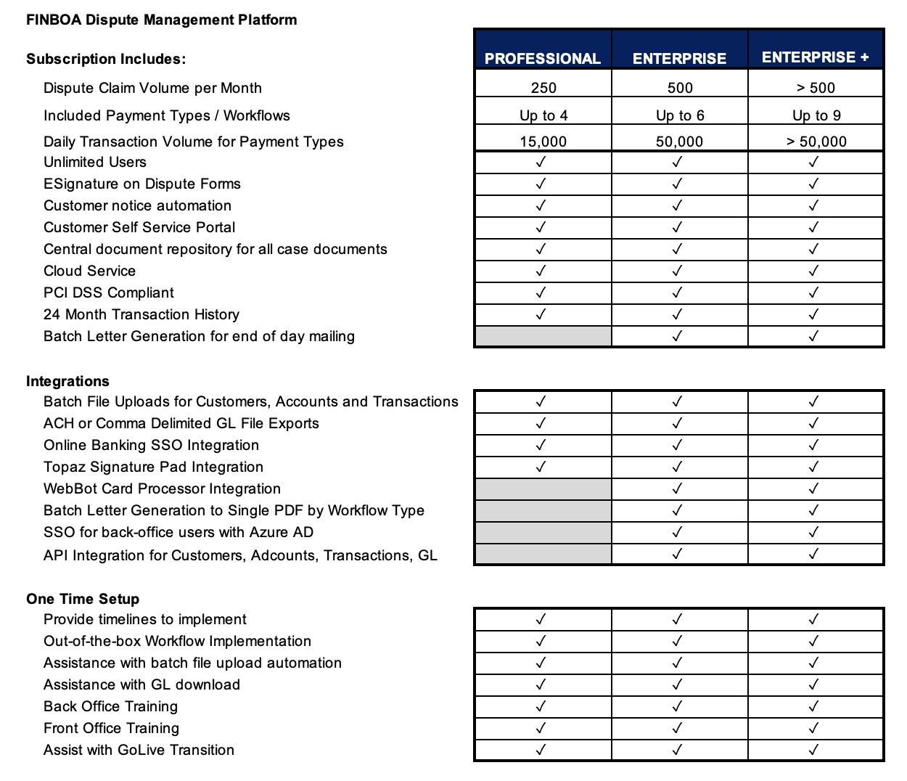
FINBOA
Product Packages
© FINBOA – Proprietary and Confidential 2022

Slide 20
Technical Overview
© FINBOA – Proprietary and Confidential 2022
‹#›

Slide 21
Customer Support / SLA
Priority 1
System unavailable
Respond: Resolve:
Under 30 minutes
Under 4 hours
Priority 2
Intermittent issues, and issues with workarounds
Respond: Resolve:
Under 60 minutes
24 hours (workaround)
Priority 3
Bugs that are not considered critical or high
Respond: Resolve:
1 Business Day
HF Release (7-14 Days)
Priority 4
Enhancements and Technical Questions
Respond: Resolve:
3 Business Days Quarterly Release
© FINBOA – Proprietary and Confidential 2022
‹#›

Slide 22
Service Credits
Incident Response Time per Calendar Month
Monthly Service Credit
Uptime Availability per Calendar Month
Monthly Service Credit
Incident Response Times between 95.0% and 98.0%
5%
99.5%
No Credit
99% to 99.5%
2.5%
Incident Response Times less than 95.0%
7.5%
98% to 99%
5%
95% to 98%
7.5%
less than 95.0%
10%
© FINBOA – Proprietary and Confidential 2022
‹#›

Slide 23
Scheduled Maintenance Window
11 PM CT Saturday - 11 PM CT Sunday
Typically, no downtime due to server redundancy
© FINBOA – Proprietary and Confidential 2022
‹#›

Slide 24
BCP / DR / HA
Azure Data Centers in the US
Primary Site: South Central US
Secondary Site: East - Virginia US
Annual DR Testing
Metrics
DR recovery time 2 - 4 hours
RPO - 2 hours
RTO - 24 hours
© FINBOA – Proprietary and Confidential 2022
‹#›

Slide 25
SOC TYPE II Compliance
Final Report Delivered in Feb 2022.
Evaluation Period: Jan - Dec 2021
Quarterly Penetration Testing (External and Internal)
© FINBOA – Proprietary and Confidential 2022
‹#›

Slide 26
PCI DSS Certification
Certified 2019-2022
2022 - 2023 Certification in Process
Scope is IaaS hosted on Azure
Quarterly Penetration Testing (External and Internal)
Annual Application Testing
© FINBOA – Proprietary and Confidential 2022
‹#›

